Slide 1

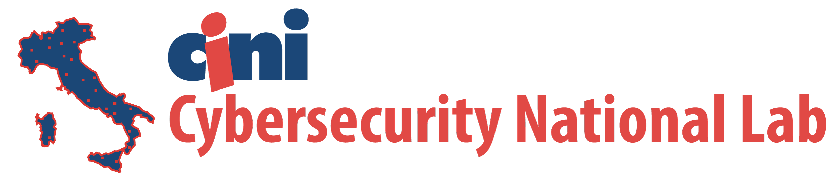
Mobile and IOT: The “ODD couple” of APPLICATION SECURITy
Alessio Merlo
DIBRIS – University of Genoa

Slide 2

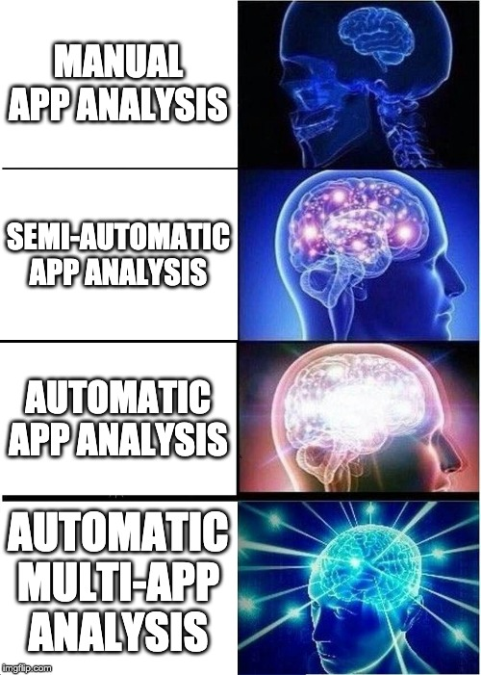


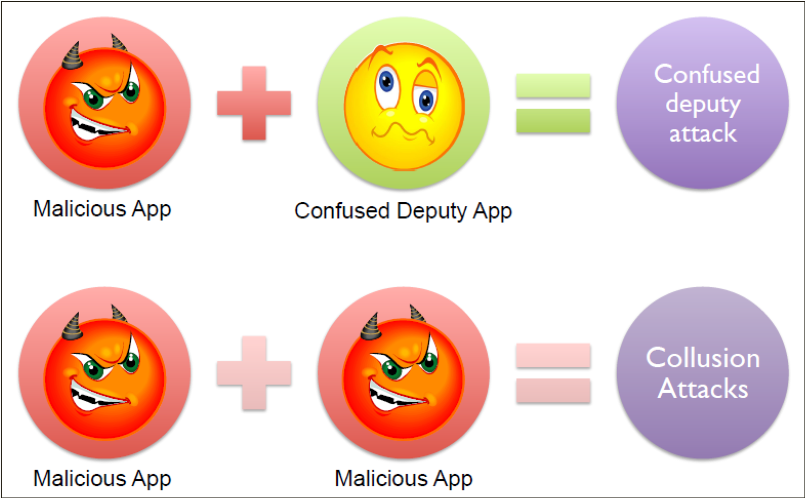
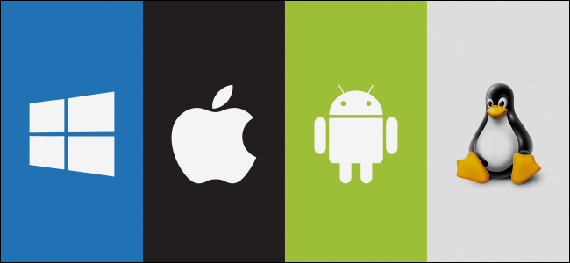
App Security in a nutshell
Aim: Developing methodologies and solutions to systematically/automatically assess the behavior of applications as well as their interactions.
Main actors:
Vulnerable apps and operating systems
Malware apps
Attack Landscape:

Slide 3
A snapshot of mobile security today
The good:
Mobile OSes are being hardened version-by-version.
App side:
Wide literature for comprehensive static and dynamic app analysis.
Malware analysis is a mature field.
The bad:
Mobile OSes keep providing new features at any release, thereby introducing new vulnerabilities and attack vectors.
App side:
Apps are going to native
What about malware?
Native on mobile is mostly unexplored and allows circumventing (most of) the existing analysis methodologies.
The ugly: IoT apps are on the rise…
Are they “harder” to analyze?
How do they affect (in case) the mobile world?

Slide 4
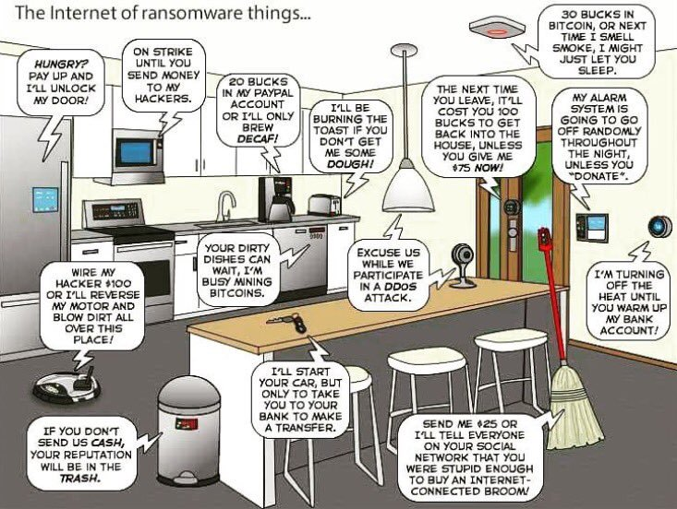






The smart lock triggered the microwave oven…
Mobile: the risk is your fault.
IoT: the risk depends on your and others’ choices.
… that enabled the lamp…
… that activated the toaster…
… that started the video entryphone…
INTERNET OF COLLUSION
… that turned on the Google Alexa…
… that your neighbor bought on Amazon (for 2 peanuts)! ☺

Slide 5
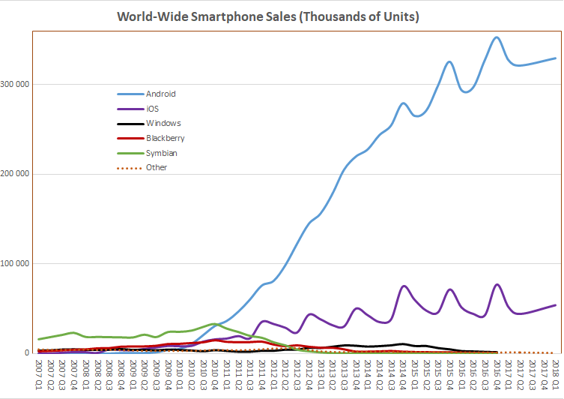
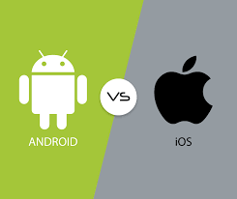
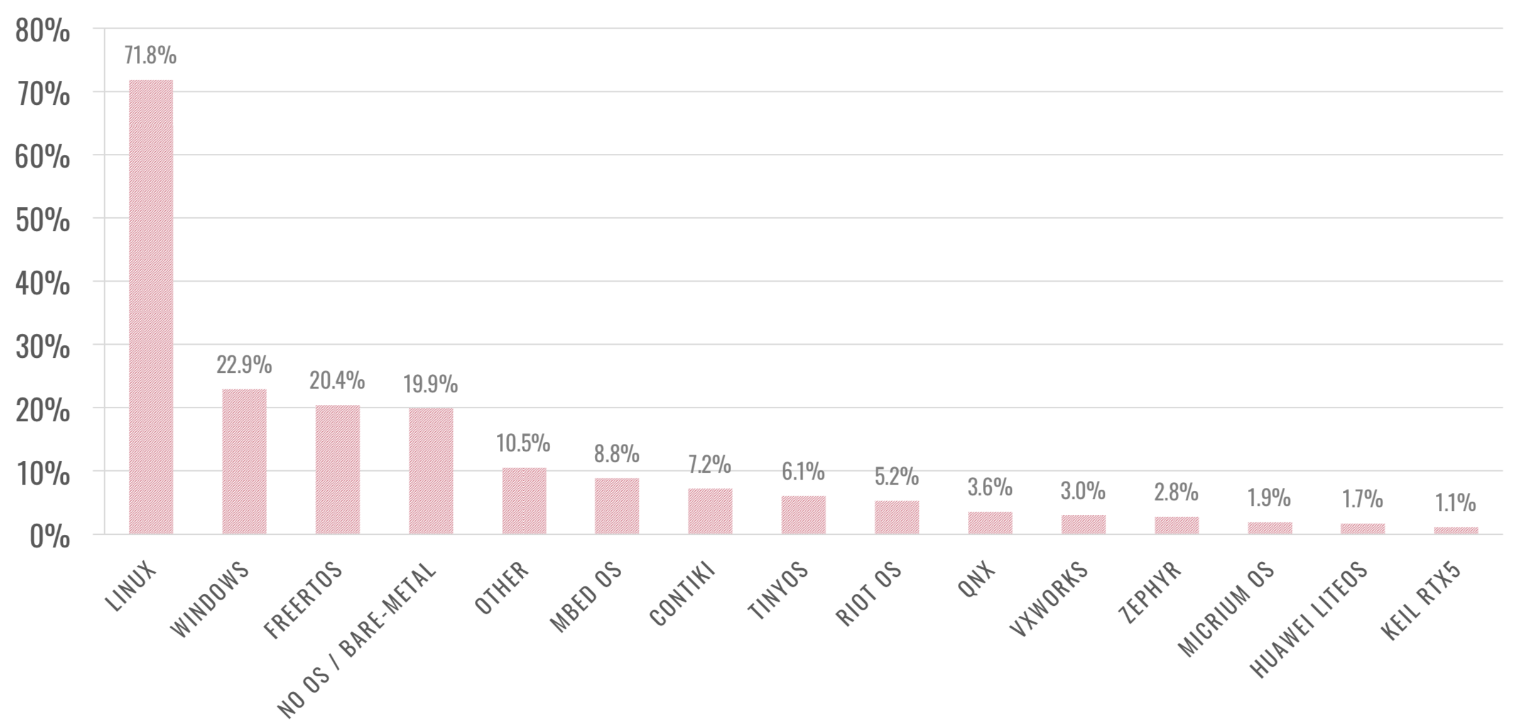
Mobile apps vs. IoT Apps: Myths or Truths
OS Landscape: duumviri (Mobile) vs. oligarchy (IoT)
Mobile’s Today
Could the future of IoT OSes be the present of Mobile OSes?
Mobile’s Yesterday

Slide 6
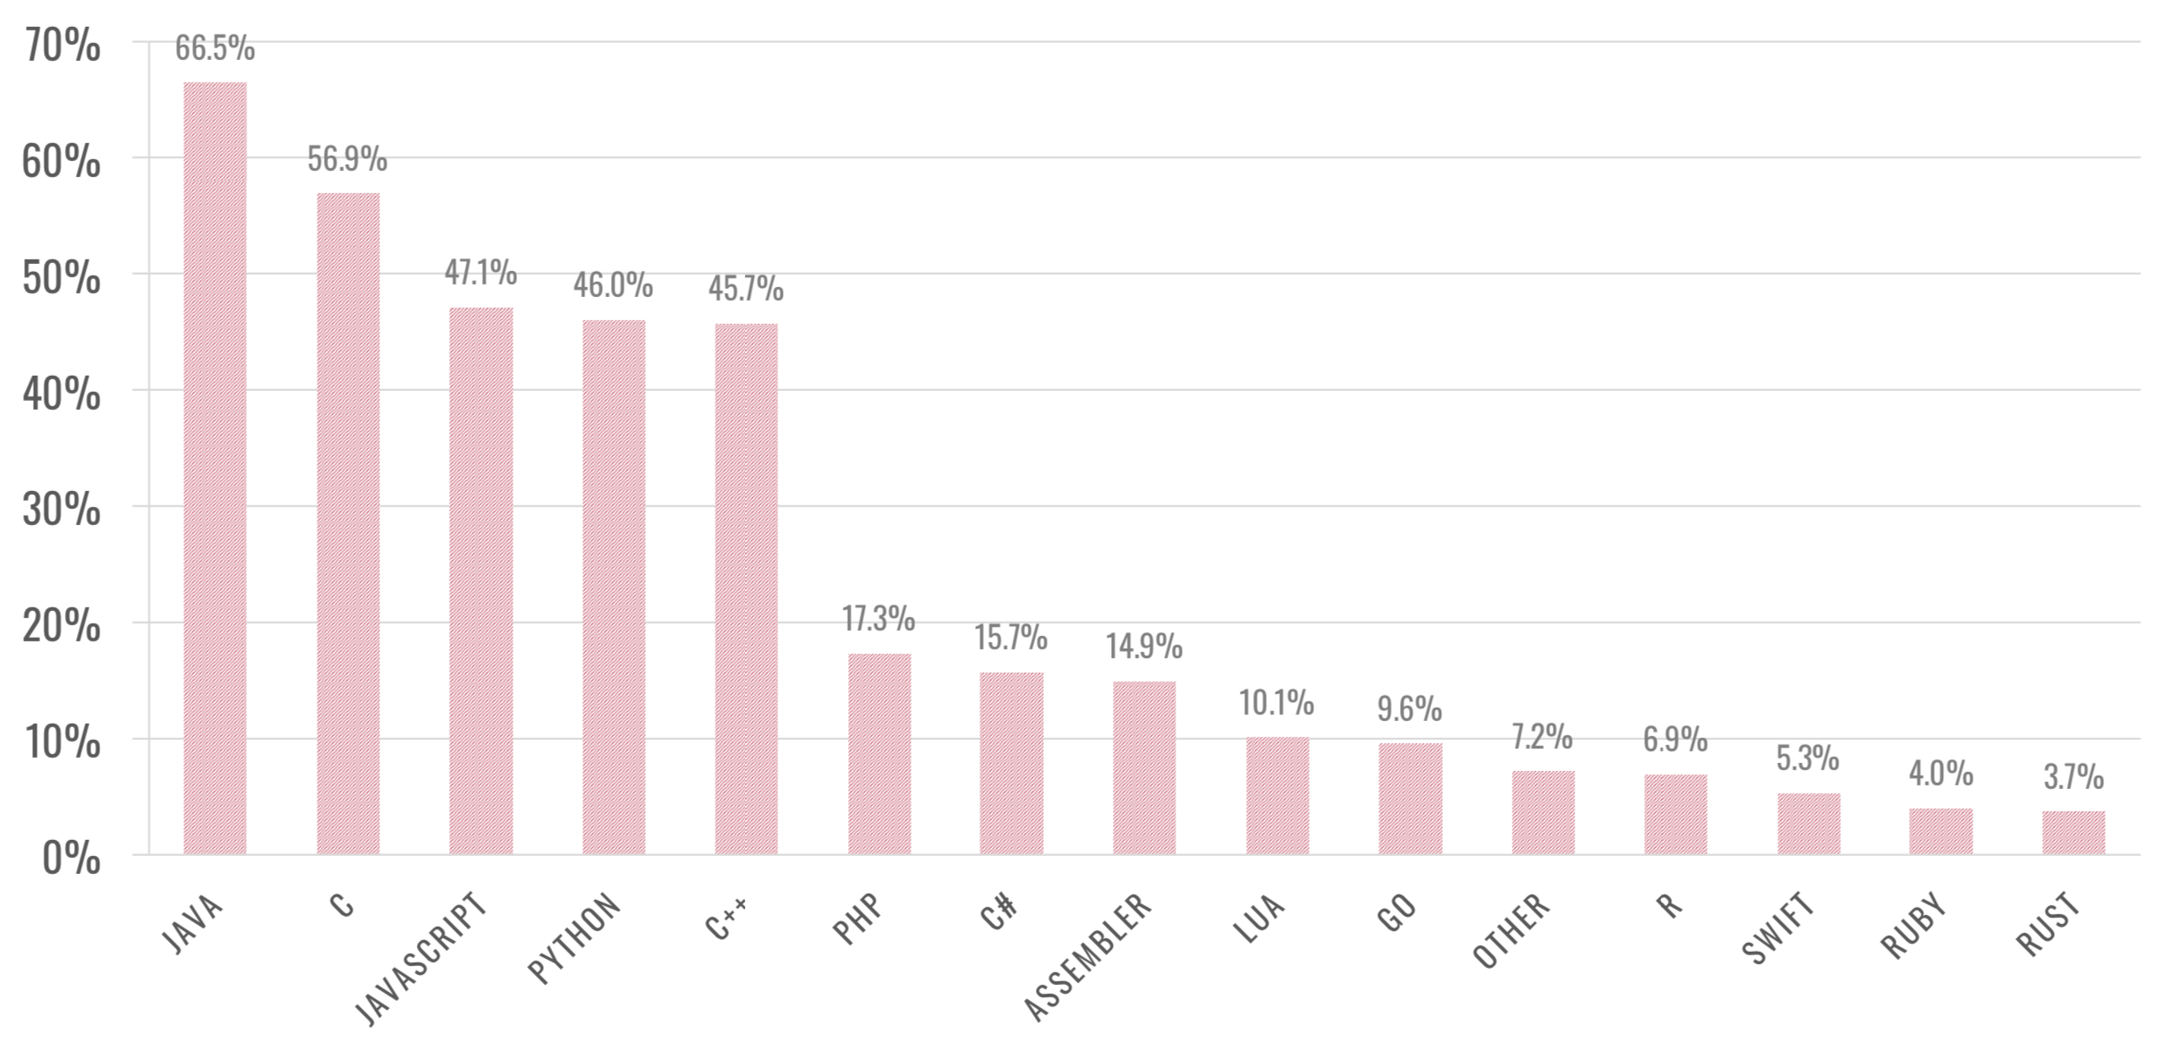


Mobile apps vs. IoT Apps: Myths or Truths
Claim 2: IoT apps are “technologically different” from Mobile apps
Can we apply some analysis methodologies from mobile apps to IoT apps?

Slide 7
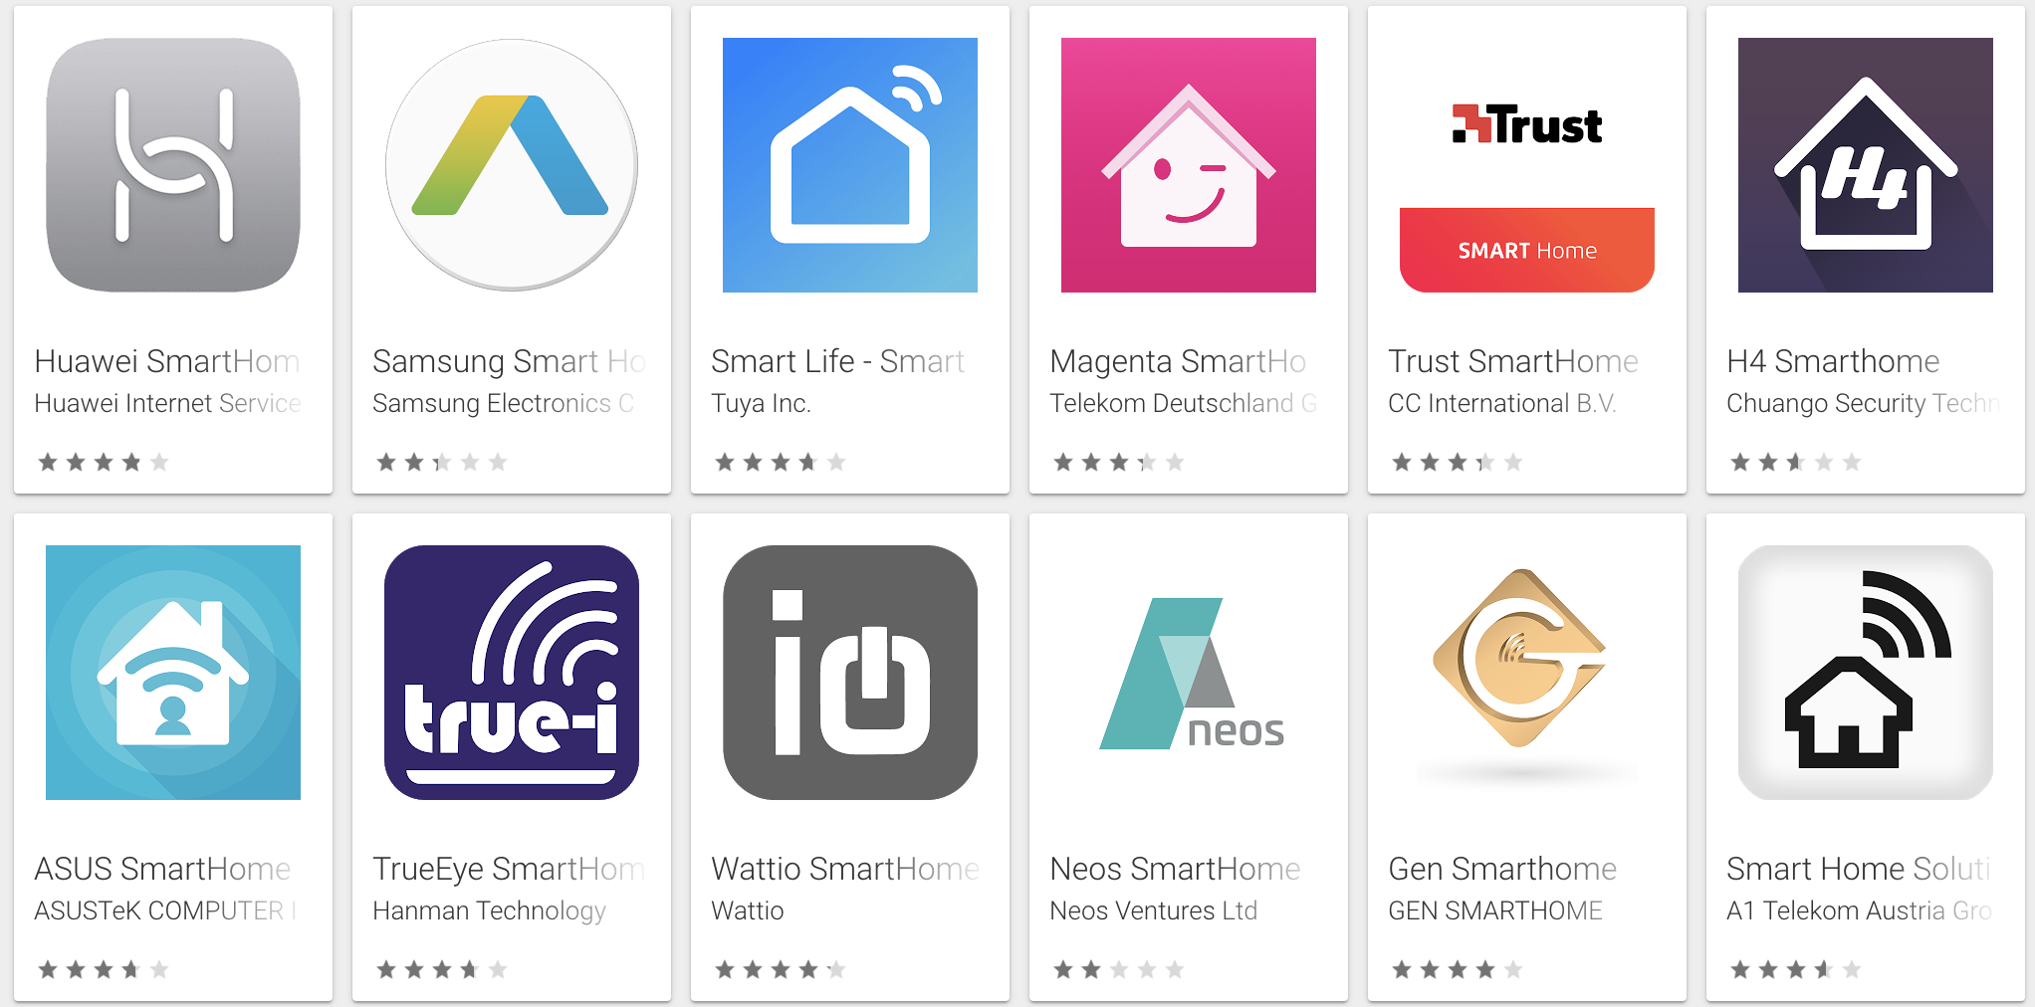
Mobile apps vs. IoT Apps: Myths or Truths
Claim 3: Closed world (Mobile) vs. Open world (IoT)
The boundary of mobile security is the device
App analysis (and collusion detection) are limited to apps running on a single device
The boundary of IoT app analysis is blurry
IoT devices are event-triggered systems that send data to (and receive command from) «the world».
IoT is expanding the boundaries of the mobile “closed world”

Slide 8
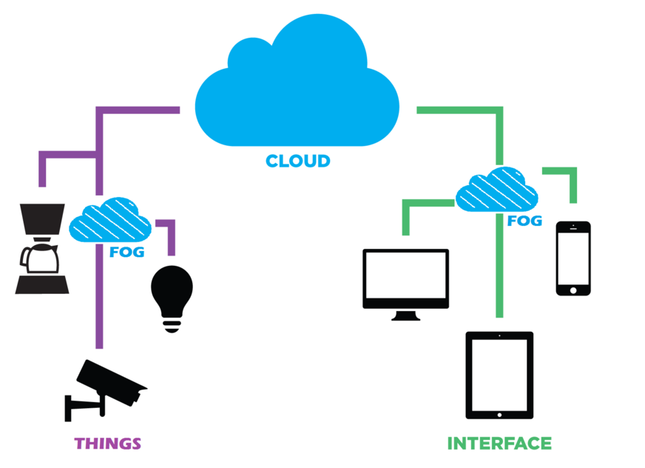
A New challenge: IoT Ecosystem
Interconnected IoT devices are managed through multi-layer/actor architecture
Heterogeneous technologies boost the complexity in security and risk assessment
Notes:
Ok let’s focus on the topic of this talk. First of all we need to discuss a little bit about the concept of IoT ecosystems.
An IoT ecosystem is basically a set of interconnected “things” that are managed through multi layer and multi actor architectures.
Indeed, in a typical IoT ecosystem there are several tecnologies involved (like mobile, fog, cloud) that allows a great versatiliy and a plethora of different use cases. However, such the interaction of such heterogeneus technologies really boost the complexits of sound security assessment strategies as we will see later on.

Slide 9
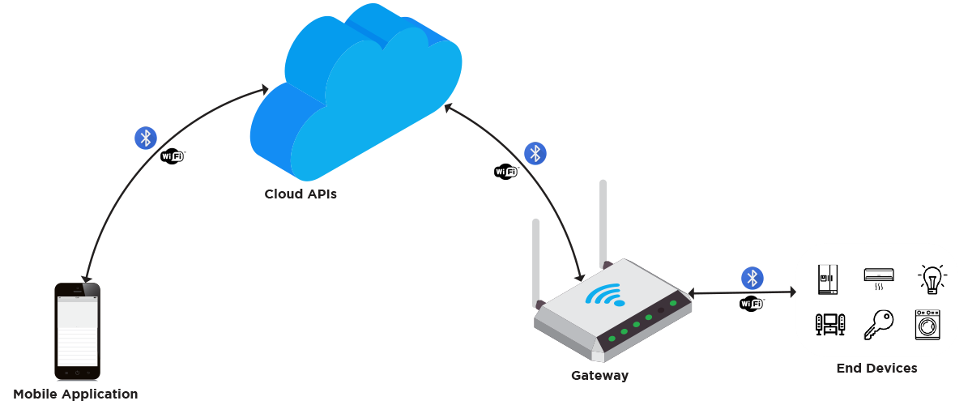
Mobile-IoT Apps Ecosystem
Notes:
In particular in this talks I would like to focus on the application of IoT ecosystem. Here we can see a typical IoT ecosystem that is able to involve different technologies. The focus is the applications since it is the piece of logic that is able to provide the desired functionalties to our ecosystem.

Slide 10
Mobile-IoT Apps Ecosystem
IoT Applications provide on-board functionalities of the “Things”
Notes:
In particular in this talks I would like to focus on the application of IoT ecosystem. Here we can see a typical IoT ecosystem that is able to involve different technologies. The focus is the applications since it is the piece of logic that is able to provide the desired functionalties to our ecosystem.

Slide 11
Mobile-IoT Apps Ecosystem
IoT Applications provide on-board functionalities of the “Things”
Mobile Applications allow the management and supervision of IoT Devices
Notes:
In particular in this talks I would like to focus on the application of IoT ecosystem. Here we can see a typical IoT ecosystem that is able to involve different technologies. The focus is the applications since it is the piece of logic that is able to provide the desired functionalties to our ecosystem.

Slide 12
Mobile-IoT Apps Ecosystem
IoT Applications provide on-board functionalities of the “Things”
Mobile Applications allow the management and supervision of IoT Devices
Notes:
In particular in this talks I would like to focus on the application of IoT ecosystem. Here we can see a typical IoT ecosystem that is able to involve different technologies. The focus is the applications since it is the piece of logic that is able to provide the desired functionalties to our ecosystem.

Slide 13
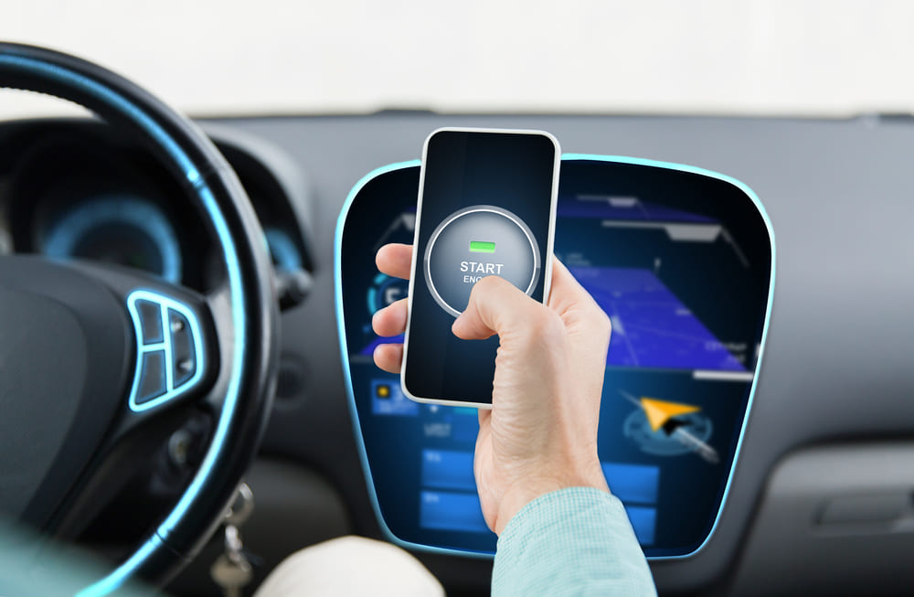
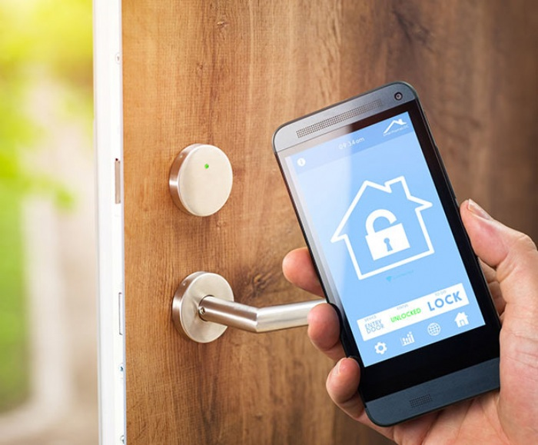
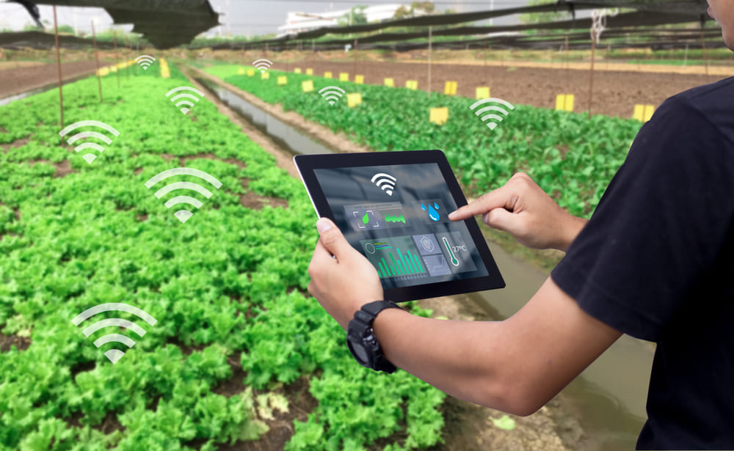

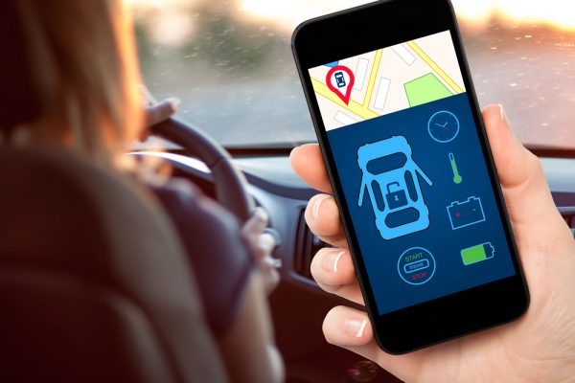
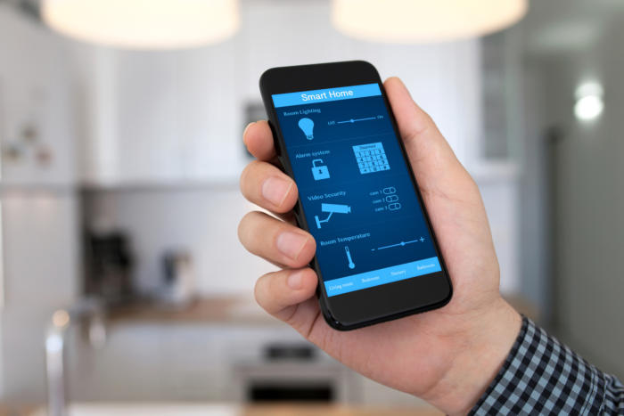
Mobile-IoT Ecosystem Use-Cases
Automotive Smart Home Industrial-IoT
Notes:
Just to support those considerations I’ve listed few use cases in which the interaction between Mobile apps and IoT apps is crucial. For instance in automotive domains, there are several mobile apps that manage the on-board sensors and even allows you to lock and unlock the car. There are also a lot of examples in Smart home environments where mobile apps are used to unlock door or to monitor the safety of houses through surveillance cameras. Plus, mobile application are used extensively in IIOT domains, especially for the supervision and management of ICS and Iot Sensors.

Slide 14
IS THERE a MOBILE-IOT SECURITY PROBLEM?
OWASP Top 10 Mobile Vulnerabilities
Improper Platform Usage
Insecure Data Storage
Insecure Communication
Insecure Authentication
Insufficient Cryptography
Insecure Authorization
Poor Code Quality
Code Tampering
Reverse Engineering
Extraneous Functionality
OWASP Top 10 IoT Vulnerabilities
Weak, Guessable, or Hardcoded Passwords
Insecure Network Services
Insecure Ecosystem Interfaces
Lack of Secure Update Mechanism
Use of Insecure or Outdated Components
Insufficient Privacy Protection
Insecure Data Transfer and Storage
Lack of Device Management
Insecure Default Settings
Lack of Physical Hardening

Slide 15
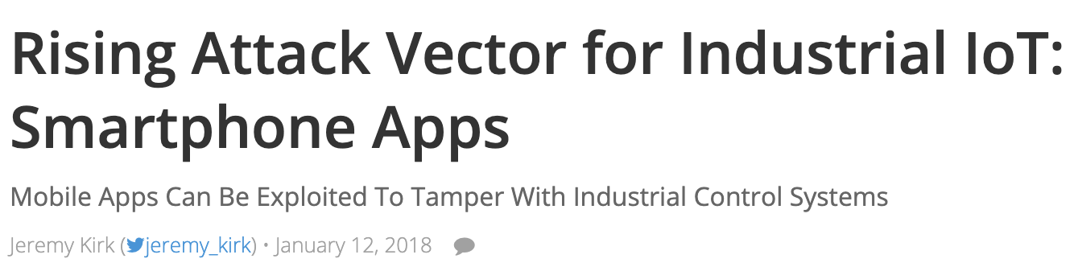
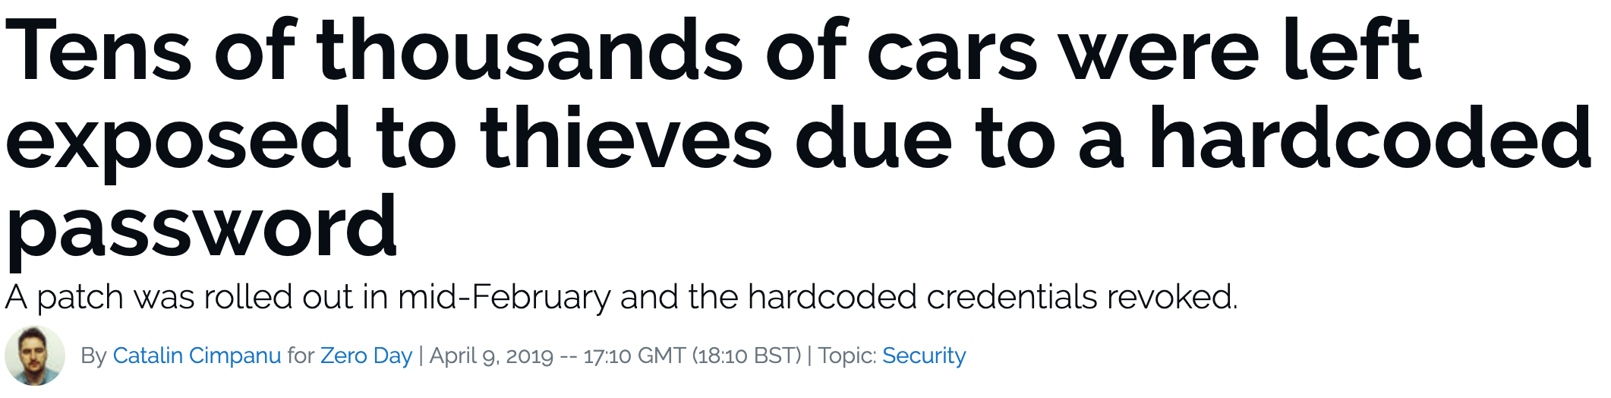
IS there «ACTUALLY» a mobile-iot seurity problem?
https://www.bankinfosecurity.com/rising-attack-vector-for-industrial-iot-smartphone-apps-a-10580
https://www.zdnet.com/article/tens-of-thousands-of-cars-left-exposed-to-thieves-due-to-a-hardcoded-password/
Notes:
Just to underline the security implications of a attack against this kind of ecosystems I’ve made a screeenshot of two among the most recent attacks that involve the interaction between Iot and Mobile apps.
The first reports a study on 34 mobile apps that allows the management of ICSes in which authors prove that by using vulnerabilities in the selected mobile apps (more than 147 security issues) they were allowed to manipulate and control the ICS systems and the IoT sensors connected.
In the second attack instead some hackers (fortunately ethical hackers) were able to indentfy a security vulnerability inside mycar mobile app for android and iOS that allow them to completely take control over the sensors of the car and also allow them to unlock remotely the vehicles. More than 10.000 cars are vulnerable to that.

Slide 16
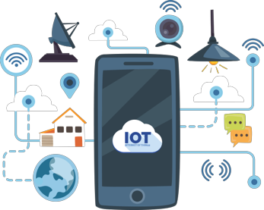
The role of Mobile Apps in the IoT Ecosystem
Mobile Applications are the primary interface for IoT-enabled devices
but also primary attack vector against IoT
Security assessment of mobile apps partaking the IoT-mobile ecosystems is critical
Notes:
So applications are really the primary intera e for IoT enabled devices, however they are also one of the primary attack vectors against the IoT ecosystem, meaning that a sound methodology for Mobile-IoT ecosystem is definitely a urgent requirement.

Slide 17
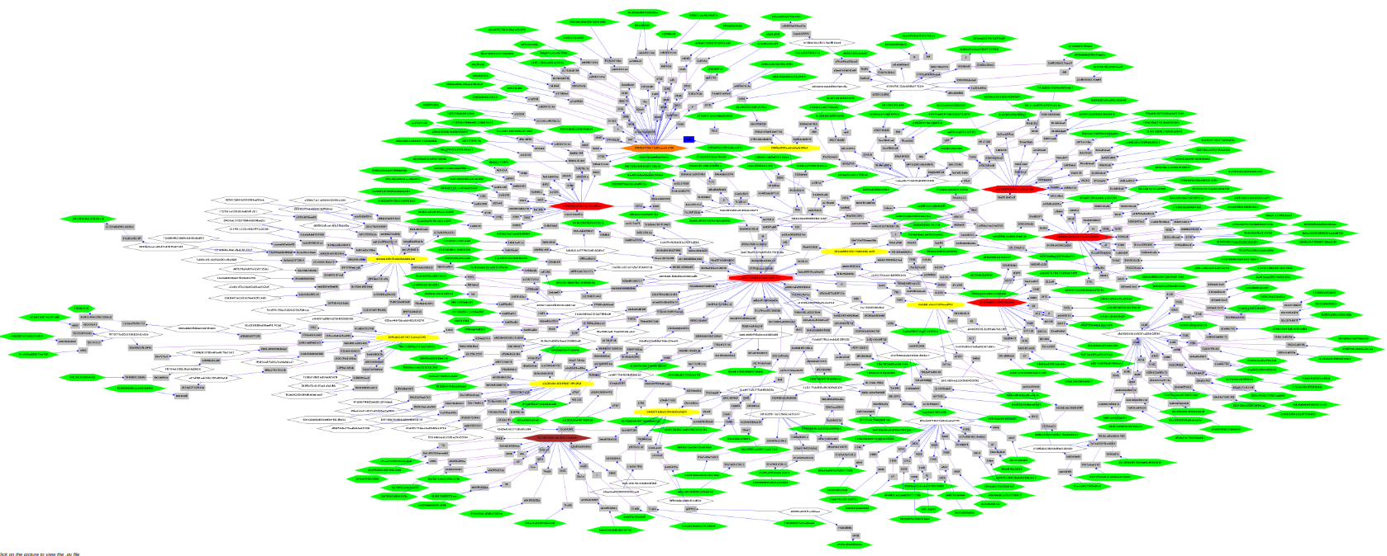
Analyzing the ecosystem: limitations
Manual security inspection does not scale
Testing does not offer adequate level of assurance
Existing techniques do not explore the interaction among different domains
Secure-SDLC is not enough to prevent security risks
Notes:
So the security evaluation of Mobile-iot apps ecosystem is a complex but very relevant task that implies several challenges from the securty point of view. Firstly testing or manual inspection are not able to scale properly according to the great complexity and high dinanimicity of the ecosystem, while on the other hand S-SDLC and existing techniques are very helpful for the mitigation of security risks but still they tend to be intra-domain and not cross-domain.
Secure Software Development Lifecycle https://www.isaca.org/Journal/archives/2017/Volume-3/Pages/security-assurance-in-the-sdlc-for-the-internet-of-things.aspx
Spiegare la parte dell’interazione tra i diversi domini soprattutto quello mobile e iot

Slide 18

A (maybe silly) Research Battle Plan
Leverage the research background in Mobile Security and Application security to build a new generation of methodologies and tools for the security analysis of the interaction among different domains.
Modeling the cross-domain → Ecosystem-level Analysis
Define automatic analysis methodologies
Understand «what to check»
Notes:
So there is a need for a research battleplan that levereages reasearch backgrounds in application security and mobile security in order to build new methodologies and tools for the security analysis of the entire mobile-iot ecosystem. Those tecnicques aim at an high-level of automation and precision but still with the scalability in mind.

Slide 19

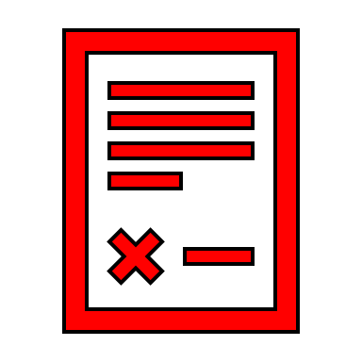

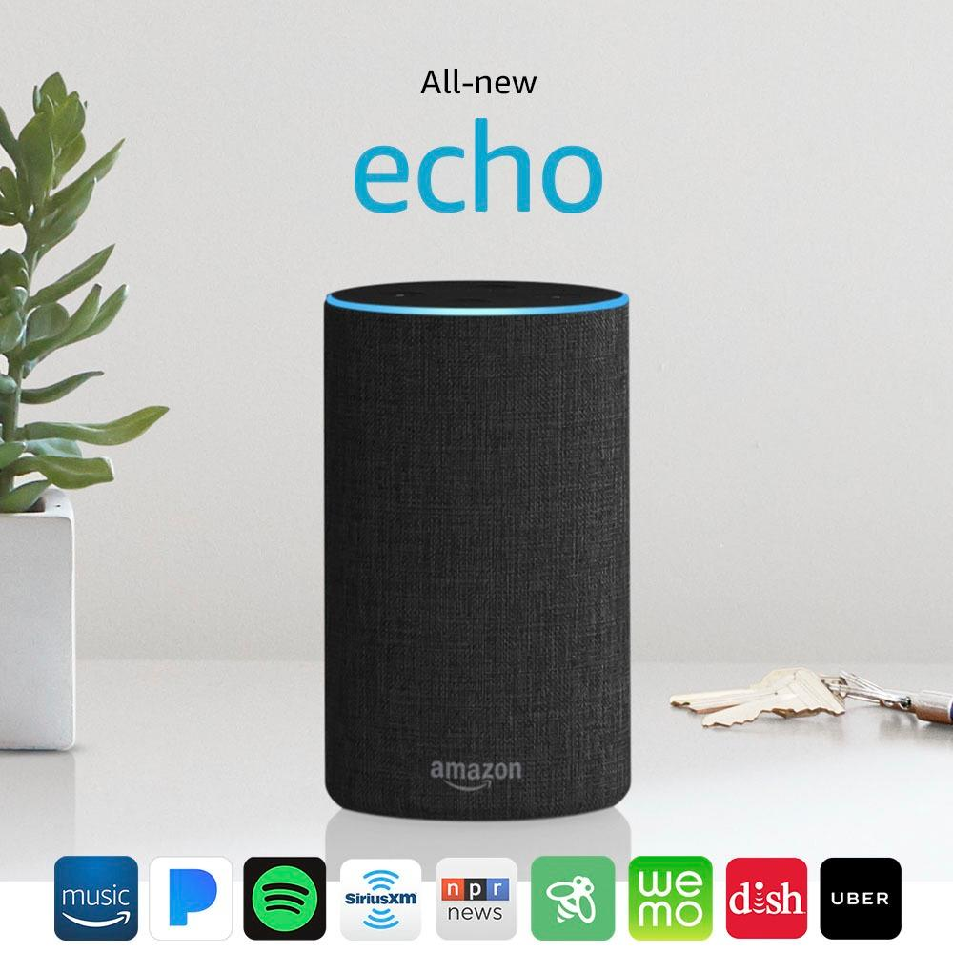



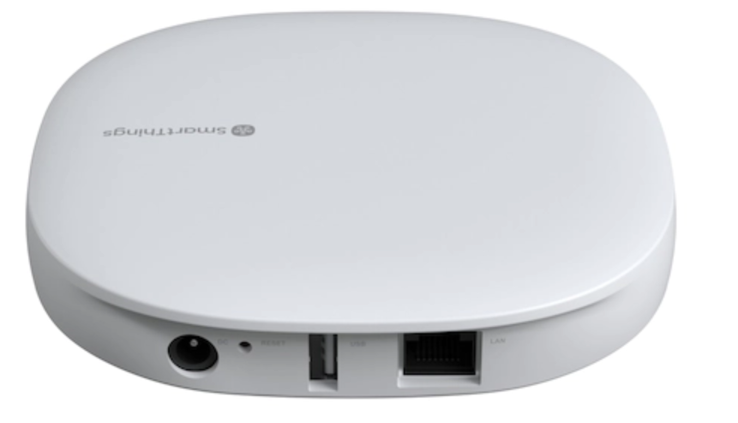
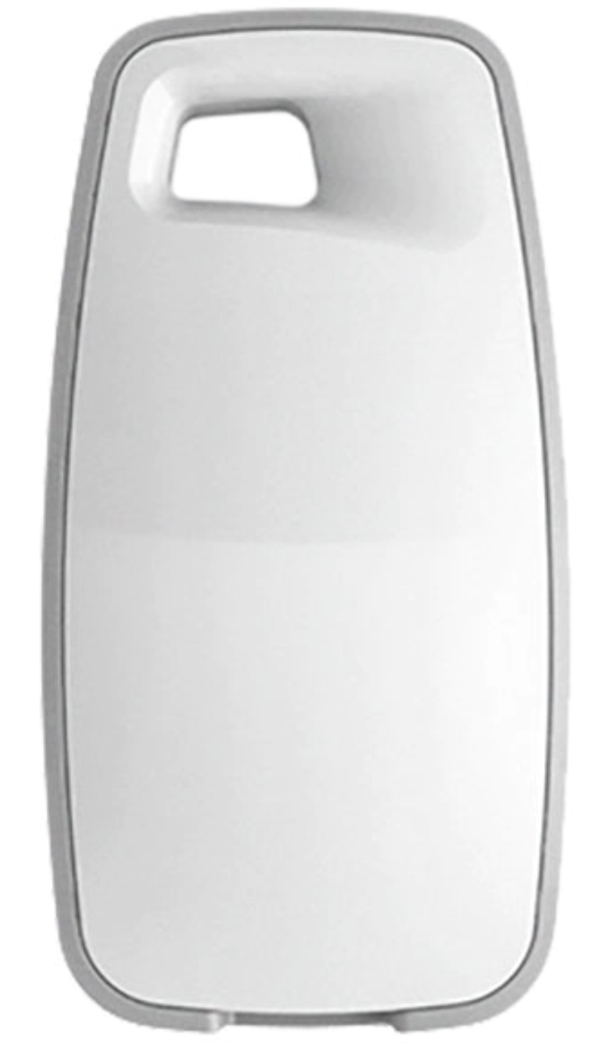
Research Challenge: META-LEVEL (STATIC) Analysis
Paradigm-agnostic modeling
Meta-language
Extract/Infer
Extract/Infer
Extract/Infer
Samsung SmartHome App
Samsung SmartHub
Samsung Arrival Sensor

Slide 20

META-LEVEL (STATIC) Analysis
«Security Policy»
OK
Model Checking/
Symbolic Execution/
Data-flow Analysis/
Taint Analysis/…
NO
Code Instrumentation/
Binary Instrumentation/…

Slide 21


A USE-CASE
Smart Home Hub
Smart Lock
Mobile App
https://github.com/tim124058/ASUS-SmartHome-Exploit

Slide 22
A USE-CASE
Smart Home Hub
Smart Lock
Mobile App
NO

Slide 23
What ABOUT DYNAMIC ANALYSIS?
Static analysis suffers from FPs: best solution is Static + Dynamic Analysis
Anyway, Dynamic Analysis on the «ecosystem» is very hard to achieve:
Dynamic analysis is strongly technology-dependent
Requires app modification (e.g., instrumentation) or a device (OS) modification (e.g., syscall log, …)
IoT device can have custom OS/firmware and can be closed source: hard to instrument.
OS and firmware instrumentation can be faulty and error-prone
Feasible for only vendor-specific, reduced-size ecosystems.
It does not scale

Slide 24
Some open ISSUES
Model granularity and analysis scaling
Do we need policy-driven optimized app models?
Meaningful security policies
Which behaviors are security-relevant?
Paradigm extension to Fog and Cloud. Do we need to extend the analysis?

Slide 25
CONCLUSIONS
Like in the «odd couple» drama, both main stars (Mobile and IoT) affect each other.
Mobile apps cross the boundary of mobile devices.
IoT apps are triggered and driven by Mobile apps.
Current «monadic» approaches to Mobile and IoT security must be extended.
Manual app analysis could be a dead-end.
Cross-fertilization among different expertise in Cybersecurity should join forces.
A joint effort between academy and industry is required.

Slide 26
Thank you!
Questions?
LZSLAKTMDDKZAL
mmm… who’s next?
It could be interesting.
Let’s talk about it.

